Slide 1

Reporting and Analyzing Current Liabilities
9
Chapter
UAA – ACCT 201 Principles of Financial Accounting Dr. Fred Barbee

Slide 2
IS FUN!
ACCT 201
Chapter 9
Day 1

Slide 3
No homework is due today!

Slide 4
Problem 9-2A is due
Wednesday!

Slide 5
Problem 9-2A is due
Thursday!

Slide 6
ACCT 201 ACCT 201 ACCT 201
Chapter 9 - Day 1
Topic | LO | Read | HW
Characteristics of Liabilities | C1 | 376-378 | QS1, E1
Known (Determinable) Liabilities | C2, P1, P2, P3 | 378-386 | E4, E5, E6, E7
Agenda
ACCT 201 ACCT 201 ACCT 201

Slide 7
Reporting and Analyzing Current Liabilities
9
Chapter
Characteristics of Liabilities

Slide 8
Characteristics of Current Liabilities
...comes
a present obligation...
From a past event...
...for future sacrifices.
Past
Present
Future
ACCT 201 ACCT 201 ACCT 201
Notes:
2
2

Slide 9
ACCT 201 ACCT 201 ACCT 201
Liabilities are obligations that use assets (usually cash) when they are paid as required.
Payment
Assets = Liabilities + Owners' Equity
Source
Source
Liabilities (and Equity) are sources of assets when they are incurred.
ACCT 201 ACCT 201 ACCT 201
Notes:
2
2

Slide 10
Classifying Liabilities
Current Liabilities
Long-Term Liabilities
Due within one year or the company’s operating cycle, whichever is longer.
Due after one year or the company’s operating cycle, whichever is longer.
ACCT 201 ACCT 201 ACCT 201
Notes:
2
2

Slide 11
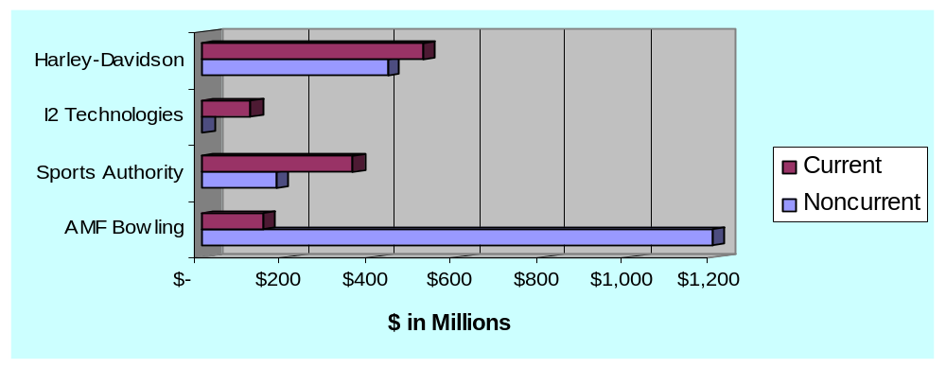
Exh.
9.2
Current and Long-Term Liabilities
$0
ACCT 201 ACCT 201 ACCT 201
Notes:
2
2

Slide 12

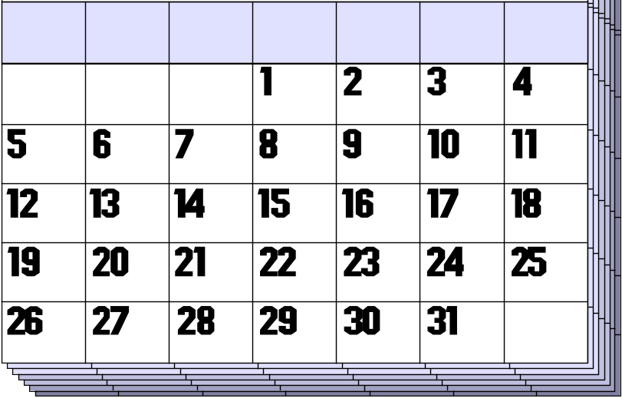

Characteristics of Current Liabilities
Who to pay?
When to pay?
How much to pay?
ACCT 201 ACCT 201 ACCT 201
Notes:
2
2

Slide 13
Reporting and Analyzing Current Liabilities
9
Chapter
Known (Determinable) Liabilities

Slide 14
Known (Determinable) Liabilities
Accounts Payable
Sales Taxes Payable
Unearned Revenues
Notes
Payable
ACCT 201 ACCT 201 ACCT 201
Notes:
2
2

Slide 15
Known (Determinable) Liabilities
Accounts Payable
Sales Taxes Payable
Unearned Revenues
Notes
Payable
ACCT 201 ACCT 201 ACCT 201
Notes:
2
2

Slide 16
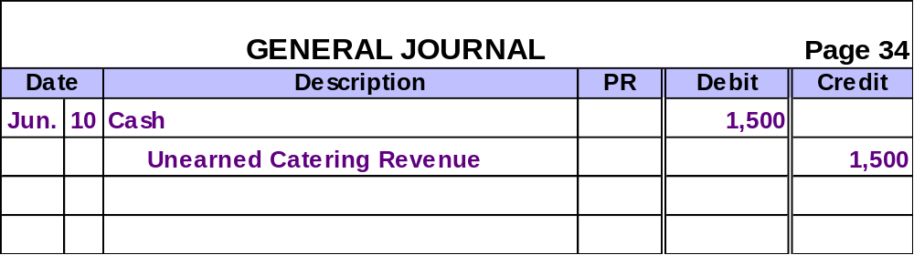
Unearned Revenues
On June 10, 2002, JJ’s Catering received $1,500 in advance for catering a party on July 4, 2002.
Prepare the entry for June 10, 2002.
ACCT 201 ACCT 201 ACCT 201
Notes:
2
2

Slide 17
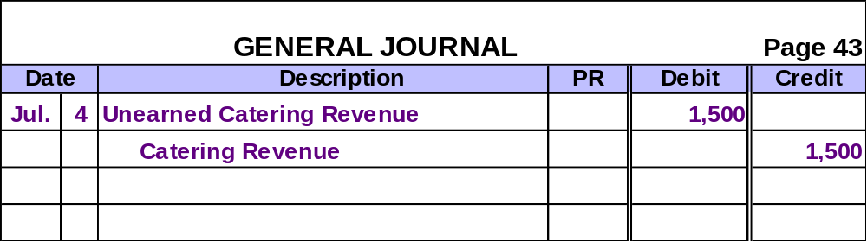
Unearned Revenues
On July 4, 2002, JJ’s Catering provided the catering services for the party.
Prepare the entry for July 4, 2002.
ACCT 201 ACCT 201 ACCT 201
Notes:
2
2

Slide 18
Known (Determinable) Liabilities
Accounts Payable
Sales Taxes Payable
Unearned Revenues
Notes
Payable
ACCT 201 ACCT 201 ACCT 201
Notes:
2
2

Slide 19
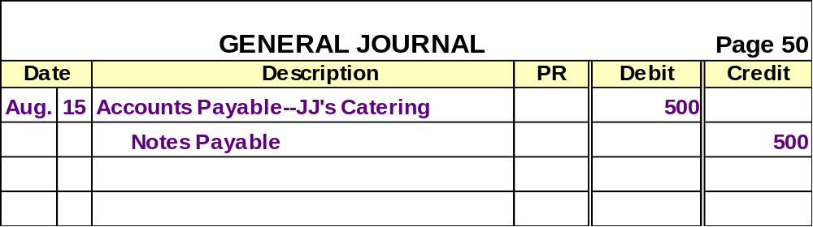
Note Given to Extend Credit Period
On August 15, 2002, Neeley Co. exchanged a $500 account payable with JJ’s Catering for a 60-day, 12%, $500 note payable.
Prepare the August 15 entry for Neeley Co.
ACCT 201 ACCT 201 ACCT 201
Notes:
2
2

Slide 20
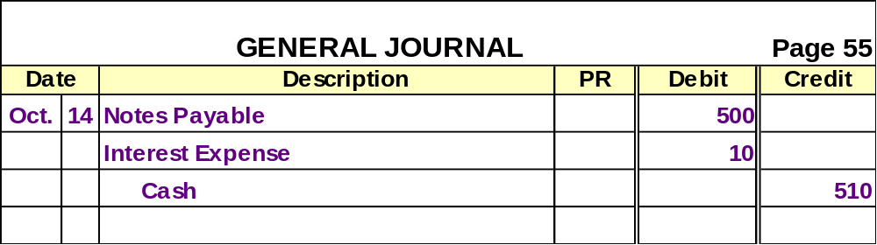
Note Given to Extend Credit Period
On October 14, 2002, Neeley Co. pays the note and interest to JJ’s Catering.
Prepare the October 14 entry for Neeley
$500 × 12% × ⁶⁰/₃₆₀ = $10
ACCT 201 ACCT 201 ACCT 201
Notes:
2
2

Slide 21

Note Given to Borrow from Bank
Face Value Equals Amount Borrowed
Cash Received Equals Face Value
Face Value Equals Amount Borrowed Plus Interest
Cash Received Is Less Than Face Value
ACCT 201 ACCT 201 ACCT 201
Notes:
2
2

Slide 22
Face Value Equals Amount Borrowed
Exh.
9.3
PROMISSORY NOTE
Face Value Date
after date promise to pay to the order of
National Bank
Boston, MA
Dollars
plus interest at the annual rate of .
$2,000
Sept. 30, 2002
Sixty days
I
Two thousand and no/100------------------------------------
12%
Janet Lee
Notes:
2
2

Slide 23
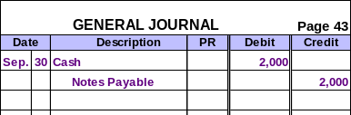
Face Value Equals Amount Borrowed
On September 30, 2002, Janet Lee would make the following entry.
What entry would she make on the maturity date of the note?
Notes:
2
2

Slide 24
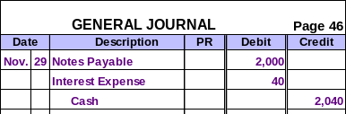
Face Value Equals Amount Borrowed
On the maturity date of the note (Nov. 29), Janet Lee would make the following entry.
$2,000 × 12% × ⁶⁰/₃₆₀ = $40
Notes:
2
2

Slide 25
Face Value Equals Amount Borrowed plus Interest
Exh.
9.4
PROMISSORY NOTE
Face Value Date
after date promise to pay to the order of
National Bank
Boston, MA
Dollars.
$2,040
Sept. 30, 2002
Sixty days
I
Two thousand forty and no/100----------------------------
Janet Lee
Notes:
2
2

Slide 26
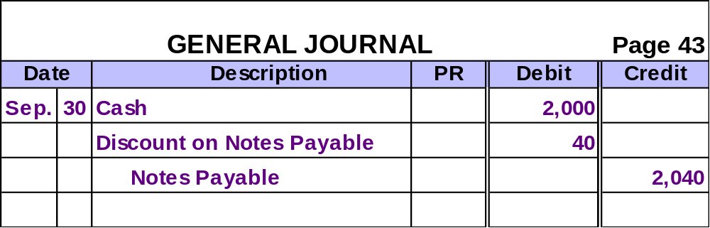
Face Value Equals Amount Borrowed plus Interest
On September 30, 2002, Janet Lee received $2,000 from the bank.
Contra-liability
Notes:
2
2

Slide 27
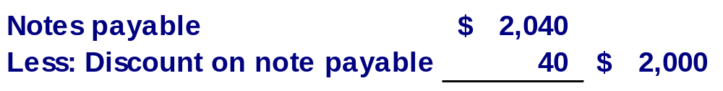
Face Value Equals Amount Borrowed plus Interest
Partial Balance Sheet
September 30, 2002
Net amount borrowed
What entry would Janet Lee make on the maturity date of the note?
Notes:
2
2

Slide 28
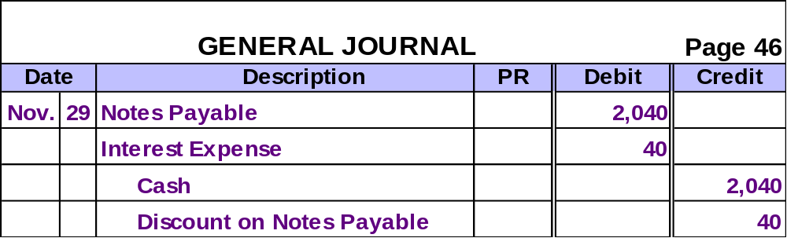
Face Value Equals Amount Borrowed plus Interest
On the maturity date of the note (Nov. 29), Janet Lee would pay off the note and recognize interest expense.
Notes:
2
2

Slide 29
End-of-Period Adjustment to Notes
Note Date
End of Period
Maturity Date
An adjusting entry is required to record Interest Expense incurred to date.
Notes:
2
2

Slide 30
End-of-Period Adjustment to Notes
Dec. 16, 2002
Dec. 31, 2002
Feb. 14, 2003
Note Date
End of Period
Maturity Date
Janet Lee borrowed $2,000 on Dec. 16, 2002, by signing a 12%, 60-day note payable.
Notes:
2
2

Slide 31
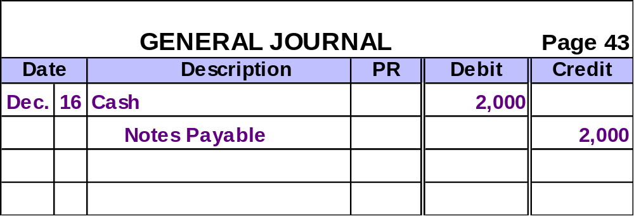
End-of-Period Adjustment to Notes
On December 16, 2002, Janet Lee would make the following entry.
What entry would she make on
December 31, 2002?
Notes:
2
2

Slide 32
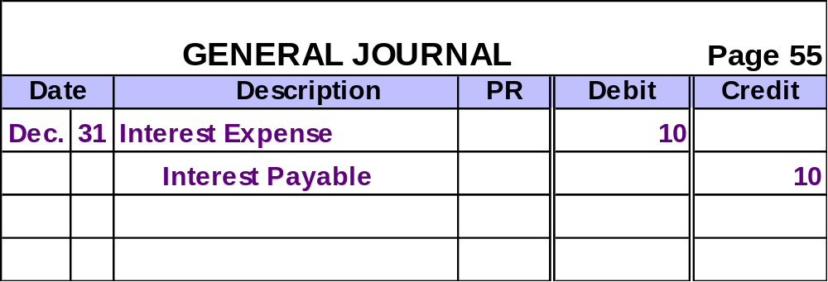
End-of-Period Adjustment to Notes
On December 31, 2002, Janet Lee would make the following entry.
$2,000 × 12% × ¹⁵/₃₆₀ = $10
Notes:
2
2

Slide 33
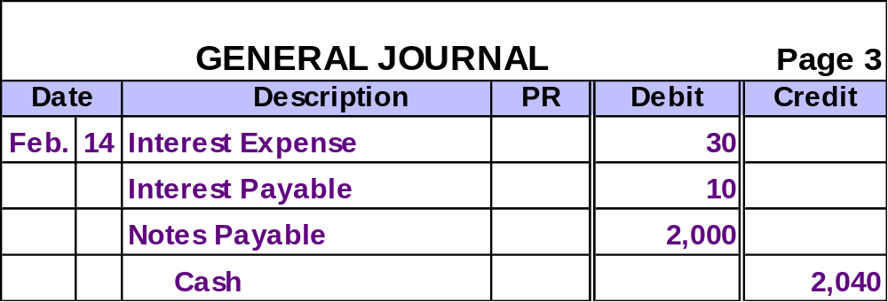
End-of-Period Adjustment to Notes
On February 14, 2003, Janet Lee would make the following entry.
$2,000 × 12% × ⁴⁵/₃₆₀ = $30
Notes:
2
2

Slide 34
Known (Determinable) Liabilities
Payroll Liabilities

Slide 35






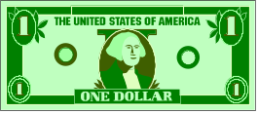
Exh.
9.5
Payroll Deductions
Gross Pay
Medicare Taxes
Federal Income Tax
State and Local Income Taxes
Voluntary Deductions
FICA Taxes
Net Pay
ACCT 201 ACCT 201 ACCT 201
Notes:
2
2

Slide 36
Employee FICA Taxes
FICA Taxes
Medicare Taxes
2002: 6.2% of the first $84,900 earned in the year.
2002: 1.45% of all wages earned in the year.
Employers owe the FICA amount withheld from employees’ gross pay to the IRS.
ACCT 201 ACCT 201 ACCT 201
Notes:
2
2

Slide 37

Employee Income Tax
State and Local Income Taxes
Federal Income Tax
Amounts withheld depend on the employee’s earnings and the tax rates.
Employers owe the income tax amounts withheld from employees’ gross pay to the appropriate government agency.
ACCT 201 ACCT 201 ACCT 201
Notes:
2
2

Slide 38
Employee Voluntary Deductions
Union Dues
Savings Accounts
Pension Contributions
Insurance Premiums
Charities
Voluntary Deductions
Amounts withheld depend on the employee’s request.
Employers owe the voluntary deductions withheld from employees’ gross pay to the designated agency.
ACCT 201 ACCT 201 ACCT 201
Notes:
2
2

Slide 39
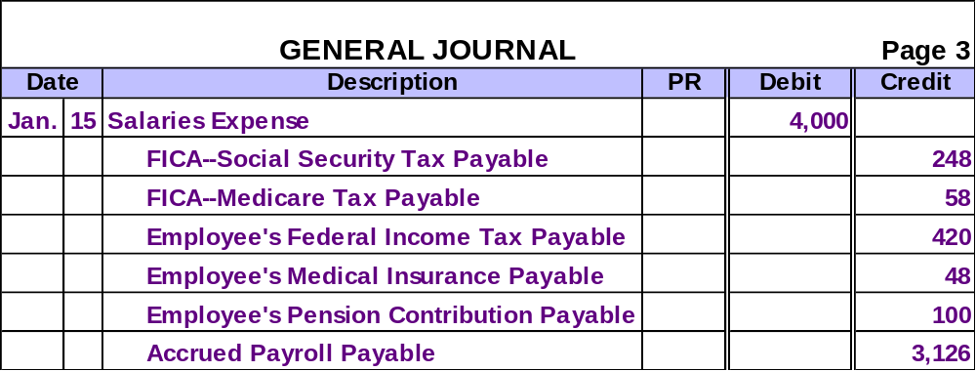
Recording Payroll Expenses and Deductions
The entry to record payroll expenses and deductions for an employee might look like this.
$4,000 × .062 = $248
$4,000 × .0145 = $58
Notes:
2
2

Slide 40

Employer Payroll Taxes
Medicare Taxes
Federal and State Unemployment Taxes
FICA Taxes
Employers pay amounts equal to that withheld from the employee’s gross pay.
ACCT 201 ACCT 201 ACCT 201
Notes:
2
2

Slide 41
Federal and State Unemployment Taxes
2000: 6.2% on the first $7,000 of wages paid to each employee (A credit up to 5.4% is given for SUTA paid.)
Federal Unemployment Tax (FUTA)
2000: Basic rate of 5.4% on the first $7,000 of wages paid to each employee (Merit ratings may lower SUTA rates.)
State Unemployment Tax (SUTA)
Notes:
2
2

Slide 42
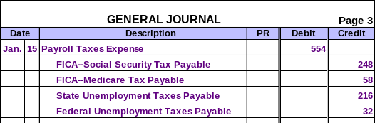
Recording Employer Payroll Taxes
The entry to record the employer payroll taxes related to the employee’s salary recorded earlier might look like this.
FICA amounts are the same as that withheld from the employee’s gross pay.
SUTA: $4,000 × .054 = $216
FUTA: $4,000 × (.062-.054) = $32
Notes:
2
2

